Slide 1

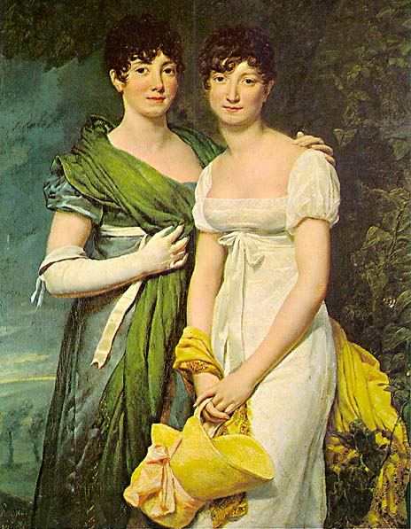
Cents and Sensibility:
Will your Technology Pay Off?
  Gretchen L. Freeman
    Associate Director
    Salt Lake County Library
  Kathleen K. Smith
    Projects Librarian
    Fresno County Library
  Lori Bowen Ayre
    Library Technology Consultant
    The Galecia Group
Public Library Association Conference
Portland, Oregon
March 23-27, 2010
Notes:
Intro of presenters and explanation of title.

Slide 2
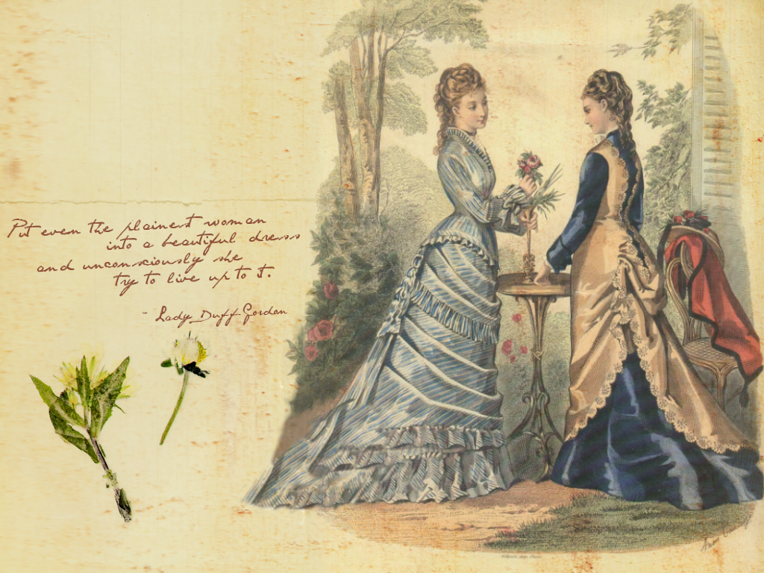
Mrs. Dashwood: “But Elinor, your heart must tell you...”
Elinor Dashwood: “In such a case it is perhaps better to use one's head.”
Sense and Sensibility by Jane Austen

Slide 3
Selling a project to your funding agency
Customer needs and convenience
New or improved services
Cost-savings—handling more work or covering more hours without additional staff is a cost savings
Staff efficiency and effectiveness
Weigh the options
Pilot test

Slide 4

Cost/Benefit Analysis
Weigh the total expected costs against the reasonably expected benefits in order to choose the best or most cost-effective option.
All our technology purchases should include a cost/benefit analysis.

Slide 5
Project Costs
One-time costs | Recurring costs
Hardware | Software maintenance
Software | Hardware maintenance
Consulting time | Supplies
Programming and analysis | Technical support
Installation & configuration | Ongoing user support
Testing/Re-testing | Replacement cycle of hardware (3-10 years)
Training
Other labor (RFID tagging)
Project management

Slide 6
Benefits
(“the steak and the sizzle”)
  Quantitative results can be touched, appraised, measured, counted, or given a value.
  Qualitative results change customer good will, employee morale, library image, amount of bureaucracy, or aesthetic appeal.

Slide 7
Existing data? New data sample?
Sample—two weeks
Don’t deal with every exception
On average what does it cost?
How do I count the qualitative?
  Surveying (public and staff)
  Media coverage
  Testimonials from target group
  “Before” and “after” photos
Notes:
“Good enough” sampling

Slide 8

Aspects of Cost/Benefit Analysis
Financial
Operational
Image
Customer

Slide 9

Financial impact
Primarily quantitative results
  Costs incurred for purchases
  Revenues generated
  Staff time (costs and savings)
  Ongoing cost of maintenance (5 years)
  Savings from anything you eliminate

Slide 10
Operational impact
Process and workflow—both quantitative and qualitative results
  Process changes
  Staffing or personnel changes
  “Quality of work life” for staff
  Relationships to other departments
  Interactions with other agencies

Slide 11

Image impact
Primarily qualitative results
What do your customers say?
How is the library perceived?
Does this technology match or improve what peer libraries offer? Leading edge?
Has there been media attention?

Slide 12

Customer impact
Are you serving more customers?
Are you attracting new customers?
Are new needs being met?
Has the quality of service improved?
Has the speed of service improved?
What do your customers say?

Slide 13
Getting started
Rule #1: Keep it as simple as possible.
Rule #2: Use available data whenever possible.
Rule #3: Avoid jargon.
Rule #4: Summarize major impacts.

Slide 14
Payback Period or “Return on Investment”
Typically our funding agency is asking how long it will take to pay for the investment through savings, e.g. how many years.
If the software costs $4,500, what is

Slide 15
Collecting Delinquent Accounts
Delinquent = Accounts owing $50+
Labor intensive, manual system
Not timely for customers or staff
Low rate of return
High level of frustration for customers and staff
Notes:
Follow good business practices/principles for holding customer responsible/accountable for loss of materials. Threshold is $50.
Was there some way to automate the system to overcome these deficits?

Slide 16
Objectives
Follow sound business practices
Be fiscally responsible
Improve timeliness
Reduce staff time
Follow People First! vision
The Library commits to deliver service
that is Friendly, Knowledgeable,
Wholehearted and Respectful

Slide 17
Financial Impact
Purchase software module for ILS – $8,500
Annual software support – $1,000
Changed from 29% recovery fee to flat $7.50 fee
Staff savings - 1.5 FTE reassigned to other duties so far

Slide 18
Financial Impact
Old System New System
10 Months 3 Months
Notes:
Average 114% increase per month

Slide 19
Financial Impact
Old System New System
10 Months 3 Months
Notes:
Average 95% increase per month

Slide 20
Financial Impact
Old System New System
10 Months 3 Months
Notes:
$ Paid at Collections average 6% per month
$ Paid/Returned at Library average 167% increase per month

Slide 21
Operational Impact
Improved reporting
  100% new accounts reported to Collections 30 days after maximum threshold is reached
  100% of payments/returns applied to the customer’s account the following business day
Simplified process empowers branch staff to assist customers immediately
Improved communication with Collections = faster problem resolution

Slide 22
Customer Impact
Easier for customers to resolve charges by simply returning materials
Respects the efforts of the customer to resolve charges
Delinquent accounts with no activity for 7 years are purged annually. Customers have a clean slate.

Slide 23
Image Impact
Avoid negative media attention by showing due diligence with delinquent accounts
Accountability that is timely
Local branches have the authority to resolve problems quickly and knowledgeably

Slide 24
After the Analysis
Communicated results
Emphasized areas for further improvements
Drew attention to other opportunities for analysis
  Subfinder™ staffing system
  Evanced™ calendaring system
  Counting Opinions™ customer satisfaction tool

Slide 25
What They’re Saying
“This new system
promises to be the best possible return on investment month after month,
year over year.”

Slide 26
“I am in need of your trusted counsel.”

Slide 27

Spread the Word!
Your project sizzles and you’ve got the data to prove it
Consultants can provide an impartial assessment documenting your success
Builds confidence for funders, staff, and users
Graphic from worddreams.wordpress.com
Notes:
Do you have the data to prove it?
Not always easy to document the results even when you know it was a success
Publish your results for funders, staff, and users

Slide 28
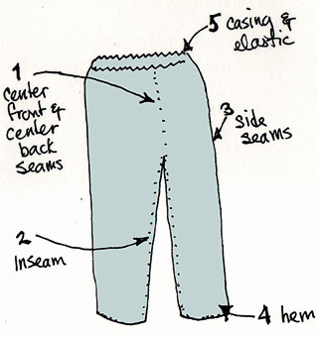
Make Critical Alterations
Poor implementation can make good choices look bad
Consultants can identify ways to get your project back on track
Add resources here…take out waste there…

Slide 29

Face Truth (and/or Consequences)
Don’t know if you did the right thing?
Lacking useful metrics?
Need help moving away from a bad decision?

Slide 30
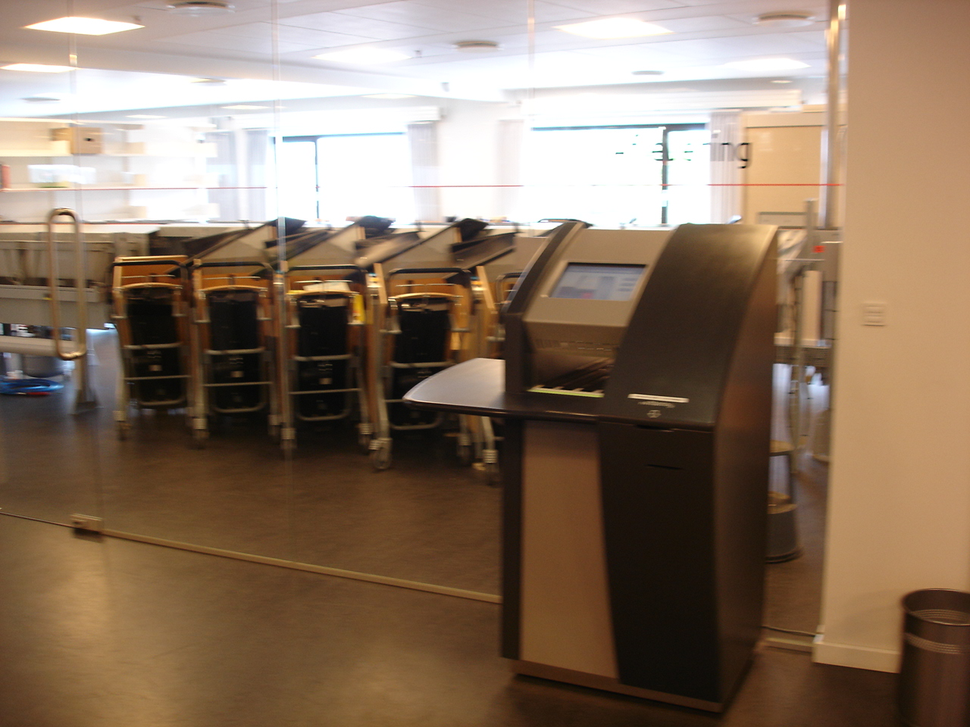
KCLS AMH Implementation
Library in midst of huge, multi-branch AMH implementation
Suddenly, Board is balking at expenditure…

Slide 31

One Way It Could Have Gone….
Notes:
Bad Outcome
Lack of cost/benefit analysis upfront causes cancellation of rest of AMH project
Entire operational plan based on AMH system called into question

Slide 32

The Way it Went
Notes:
Good Outcome
Consultant able to perform after-the-fact cost/benefit analysis
Board worries allayed
Project moves forward with strong support

Slide 33
Critical Success Factors
Useful metrics developed from comparison of libraries with AMH and lacking AMH
Converted some qualitative factors to quantitative
  daily cost of book on a shelving cart
  staff costs related to backlogs
  customer costs
Able to show financial, operational, image, and customer impacts

Slide 34
Summary of Cost Comparison
Total Annual Costs Eliminated with Automated Check-in |  |  |  | $228,605
 | Percentage of Total |  |  | Cost
Annual Cost of Unavailable Resources | 5.7% |  |  | $ 12,950
Annual Cost of Frontline Staff Time | 24.1% |  |  | $ 55,098
Annual Cost of Backroom Staff Time | 33.1% |  |  | $ 75,712
Annual Cost of Customer Time | 37.1% |  |  | $ 84,845

Slide 35
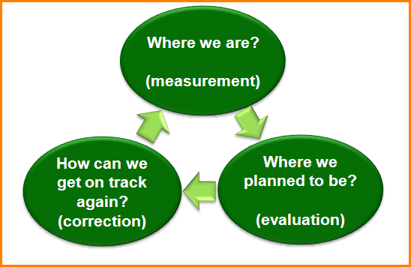
Project Management Basics
Notes:
Once it is clear the decision was a bad one….suck it up and move on!
Follow Project Management principles
Even if pilot testing not possible, risk assessment phase can prevent your library from making a big gnarly mistake
Failing isn’t all bad – you learn more from failures than success.

Slide 36
Wise Counsel
Use project management techniques
Establish objectives and metrics
Keep measuring
If technology is not achieving goal, do something!

Slide 37

Resources
The IT Payoff: measuring the business value of information technology investments / Sarv Devaraj and Rajiv Kohli, New York: Prentice Hall, c2002.
How to measure anything : finding the value of "intangibles" in business / Douglas W. Hubbard, John Wiley & Sons, c2007
Measuring Your Library's Value: How to Do a Cost-Benefit Analysis for Your Public Library / Donald S. Elliott, Glen E. Holt, Sterling W. Hayden, Leslie Edmonds Holt.
“Technology and the Return on Investment” by Karen Coyle, Journal of Academic Librarianship, August, 2006, v. 32 n. 5.

Slide 38
More Resources
RFID Implementations in California Libraries: Costs and Benefits / Elena Engel, July, 2006.
Cost Savings of Automated versus Manual Materials Handling Operations at King County Library System / Lori Bowen Ayre, January 26, 2009.
Breakthrough Technology Project Management / Bennet P. Lientz and Kathryn P. Rea, Academic Press, 1999.
“HF RFID versus UHF RFID – Technology for Library Service Transformation at City University of Hong Kong” by Steve H. Ching and Alice Tai, Journal of Academic Librarianship, August, 2009, v. 35, n. 5.

Slide 39
Cents and Sensibility:
Will your Technology Pay Off?
  Gretchen L. Freeman
    Associate Director
    Salt Lake County Library
  Kathleen K. Smith
    Projects Librarian
    Fresno County Library
  Lori Bowen Ayre
    Library Technology Consultant
Public Library Association Conference
Portland, Oregon
March 23-27, 2010

Slide 40
Mrs. Dashwood: “But Elinor, your heart must tell you...”
Elinor Dashwood: “In such a case it is perhaps better to use one's head.”
Sense and Sensibility by Jane Austen

